Slide 1
Text Classification
CS 162: Natural Language Processing
Nanyun (Violet) Peng
Course website: https://vnpeng.net/cs162_win23.html
syllabus,
announcements,
slides,
homeworks
1
Notes:
Recap and contextualize it to NLP. Also sometimes requires you to pretend you haven’t learned ML and try to solve the problem.

Slide 2
Announcement
The project description will be released Next Monday!
You probably won’t be ready to do the project now.
However, you can get familiar with the problem.
And you should start finding your teammates
Teaming/project planning report due on Week 4 Monday.
we hope the project description can help you get a better idea about teaming.
TA sessions (particularly week 1-6) will prepare you for the project, too
I will distribute google cloud computing credit
It can be used towards your homework and the project.
TA sessions will cover tutorials to GCC this Friday!

Slide 3

Is this spam?

Slide 4
What is the subject of this medical article?
MEDLINE Article
MeSH Subject Category Hierarchy
Antogonists and Inhibitors
Blood Supply
Chemistry
Drug Therapy
Embryology
Epidemiology
…
?

Slide 5
Positive or negative review?
...zany characters and richly applied satire, and some great plot twists
…It was pathetic. The worst part about it was the boxing scenes...
...awesome caramel sauce and sweet toasty almonds. I love this place!
...awful pizza and ridiculously overpriced...

Slide 6
Positive or negative review?
+
...zany characters and richly applied satire, and some great plot twists
It was pathetic. The worst part about it was the boxing scenes...
...awesome caramel sauce and sweet toasty almonds. I love this place!
...awful pizza and ridiculously overpriced...
−
+
−

Slide 7
Any other text classification tasks?

Slide 8
Text Classification
Sentiment analysis
Spam detection
Authorship identification
Language Identification
Assigning subject categories, topics, or genres
…

Slide 9
Sentiment Analysis
Sentiment analysis for movie reviews:
This is a classification task: the input is free text and the output is a label (among several fixed choices).
In this lecture, input/observed data is denoted as x (a vector), representing a sequence of words, and output/prediction is y (a scalar), representing the label.
Classifier
9
Notes:
Pause for brainstorming. Ask how many people learned basic classifiers.

Slide 10
Why sentiment analysis?
Movie: is this review positive or negative?
Products: what do people think about the new iPhone?
Public sentiment: how is consumer confidence?
Politics: what do people think about this candidate or issue?
Prediction: predict election outcomes or market trends from sentiment

Slide 11
A Rule-Based Classifier
Filled with horrific dialogue, laughable characters, a laughable plot, and really no interesting stakes during this film…
good = {‘awesome’, ‘love’, ‘great’, ...}
bad = {‘worst’, ‘terrible’, 'boo', ...}
score = 0
for w in x:
if w in good:
score +=1
elif w in bad:
score -=1
if score >= 0:
return 'pos'
return 'neg'
from our pos/neg
word list!
x
C
y
11

Slide 12
What’s the problem of the rule-based classifiers?
Coverage
Negation
Word composition
Domain differences
Emerging words/concepts
Word sense ambiguity
……
12
Notes:
This is awfully good

Slide 13
Supervised Classification
Data-driven approaches:
Our intuitions about word sentiment aren't perfect
Supervised learning = learn from labeled examples. Recipe:
training corpus of (x, y) (review, label) pairs
learning algorithm/model
13

Slide 14
Notation
Training examples:
Texts: X = (x₁, x₂, ..., x_{N})
Labels: Y = (y₁, y₁, ..., y_{N})
A classifier C maps x_{i} to y_{i}
A learner L infers C from (X, Y)
x_{i}
C
y_{i}
X
L
C
Y
14

Slide 15
A Probabilistic Classifier
Learning a probabilistic model for p(y|x)
x: Filled with horrific dialogue, laughable characters, a laughable plot, and really no interesting stakes during this film, "Star Wars Episode I: The Phantom Menace" is not at all what I wanted from a film that is supposed to be the huge opening to the segue into the fantastic Original Trilogy. The positives include the score, the sound...
y: positive or negative
probs = <model for p(y|X)>
return argmax_y p(y|X)
x
C
y
How do we build the model for p(y|x)? ==> discussion
15
Notes:
(pause for discussion)

Slide 16
A probabilistic model that generalizes
Direct MLE estimation of p (y|Filled with horrific...)
How?
Recall: multinominal distribution ➔ how to do MLE estimation for a multinominal distribution? Additional reading: https://blog.jakuba.net/maximum-likelihood-for-multinomial-distribution/
Will it work (why?)
16
Notes:
count-and-divide

Slide 17
A probabilistic model that generalizes
So, instead of estimating p(y|Filled with horrific...) directly, let's make two modeling assumptions:
The Bag of Words (BoW) assumption: Assume the order of the words in the document doesn't matter: p(Y|Filled with horrific ...) = P(Y|with, horrific, Filled, ...)
a sequence
independent word events
What simplification does the BoW assumption bring?
So called because a bag or multiset is a data structure that stores counts of elements, but not their order.
17
Notes:
Lily likes the movie = the movie likes lily.

Slide 18
6.1
18

Slide 19
A probabilistic model that generalizes
Is the BoW assumption enough? Why?
The Naive Bayes assumption: Words are independent conditioned on their class: P(Filled, with, horrific... | Y) = P(Filled | Y) x P(with | Y) x P(horrific | Y) ... Instead of P(Filled | Y, with, horrific, ...) x P(with | Y, horrific, ...) x P(horrific | Y, ...) ...
what simplification does this assumption bring?
(More discussions/reasoning about this assumption later)
Wait, but we were estimating P(Y|with, horrific, Filled, ...). What should we do?
Bayes Rule!
19

Slide 20
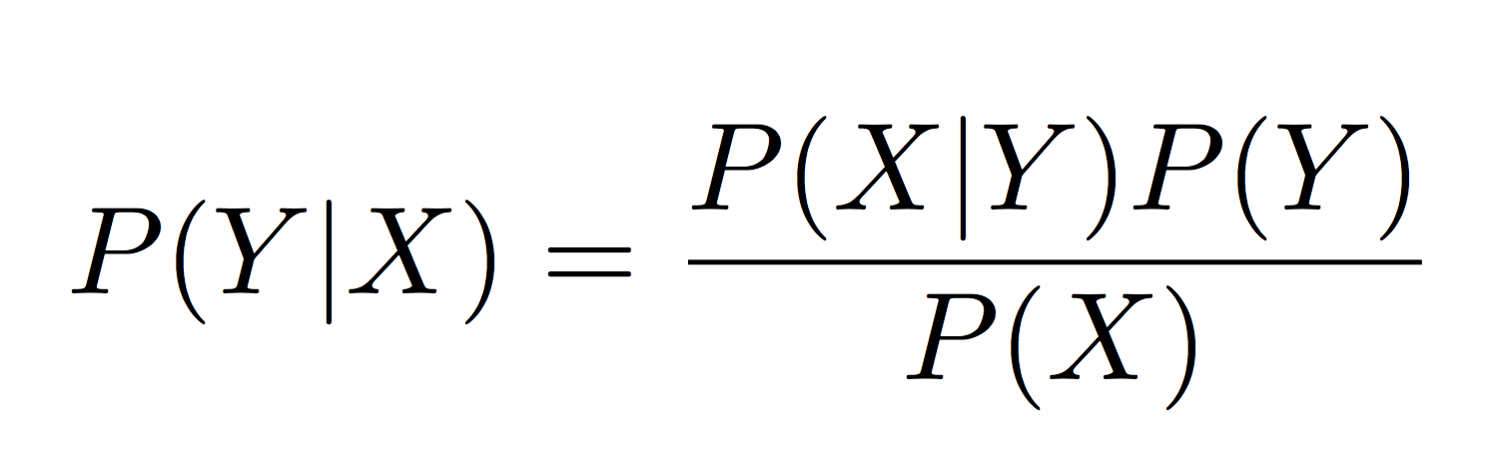
Bayes Theorem
Posterior probability: What is the probability of Y given that X is observed?
Likelihood of the data: What is the likelihood of observing X given a specific Y?
Prior probability of the label: What is our belief in Y before we see X?
20

Slide 21
A probabilistic model that generalizes
Put the assumptions/rule together:
p(Y|Filled with horrific ...) = P(Y|with, horrific, Filled, ...) //BoW assmptn
∝ P(Y) x P(with, horrific, Filled, ...|Y) //Bayes' rule
= P(Y) x P(with|Y) x P(horrific|Y) x P(Filled|Y)... //Naive Bayes assumption
21

Slide 22
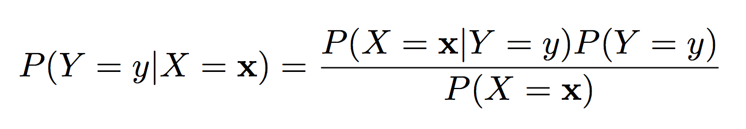
MAP prediction
Let’s use the Bayes rule for predicting y given an input x
Posterior probability of label being y for this input x
22

Slide 23
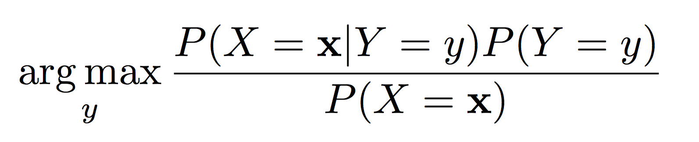
MAP prediction
Let’s use the Bayes rule for predicting y given an input x
Predict y for the input x using
23

Slide 24
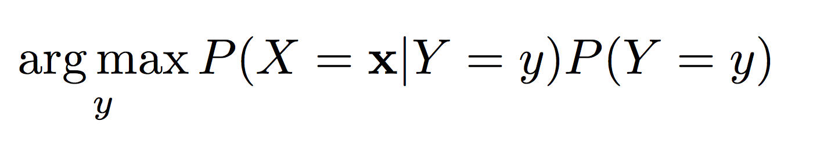
MAP prediction
Let’s use the Bayes rule for predicting y given an input x
Predict y for the input x using
24

Slide 25
MAP prediction
Predict y for the input x using
Likelihood of observing this input x when the label is y
Prior probability of the label being y
All we need are these two sets of probabilities
How to estimate them?
25

Slide 26
How hard is it to learn probabilistic models?
Classifier
Prior P(positive) : A single number (Why only one?)
Likelihood P(X | positive/negative)
There are n words
For each value of positive/negative, we need a value for each possible assignment: P(x₁ x₂ x₃ x_{n} | positive/negative) ==> how many parameters?
(V^{n} – 1) parameters for each label (V = vocabulary size)
a lot of parameters!!
Need a lot of data to estimate these many numbers!
26

Slide 27
How hard is it to learn probabilistic models?
Prior P(Y)
If there are k labels, then k – 1 parameters
Likelihood P(X | Y)
We need a value for each possible P(x₁ x₂ ☹ x_{d} | y) for each label value y
Need a lot of parameters!!
Need a lot of data to estimate these many numbers!
High model complexity
If there is very limited data, high variance in the parameters
How can we deal with this?
Answer: Make independence assumptions
27

Slide 28
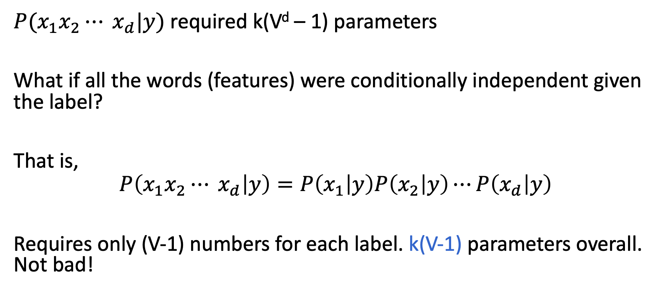
Modeling the features
$P(x_{1}x_{2}⋯ x_{d}|y)$ required k(V^{d} – 1) parameters
What if all the words (features) were conditionally independent given the label?
That is,
$$P\left(x_{1}x_{2}⋯ x_{d} | y\right)=P\left(x_{1} | y\right)P\left(x_{2} | y\right)⋯P\left(x_{d} | y\right)$$
Requires only (V-1) numbers for each label. k(V-1) parameters overall. Not bad!
The Naïve Bayes Assumption
28

Slide 29
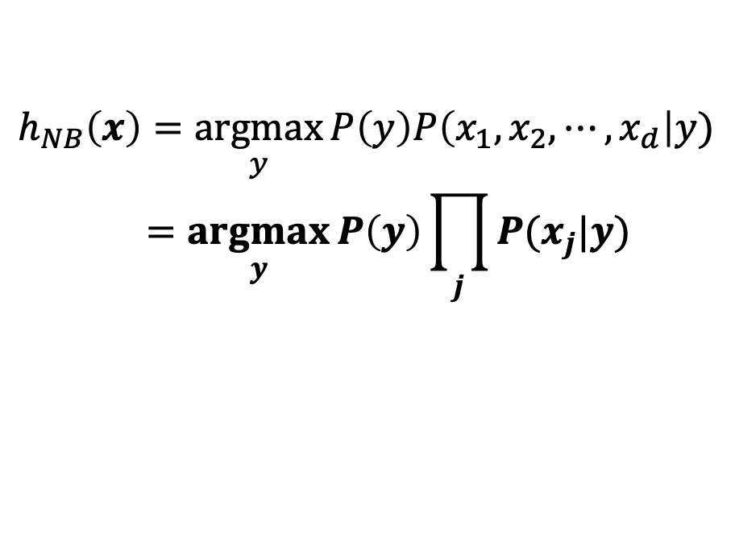
The Naïve Bayes Classifier
Assumption: Features (words in sentences) are conditionally independent given the label Y
To predict, we need two sets of probabilities
Prior P(y)
For each x_{j}, we have the likelihood P(x_{j} | y)
Decision rule
$$h_{NB}\left(x\right)=\underset{y}{argmax}{P\left(y\right)P\left(x_{1},x_{2},⋯, x_{d}\right|y)}$$
$$=\underset{y}{argmax}{P\left(y\right)\prod_{j}{P(x_{j}|y)}}$$
29

Slide 30
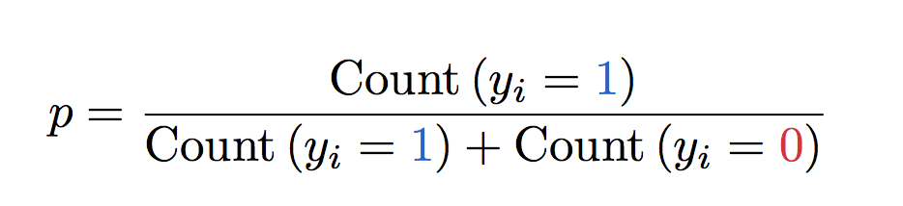
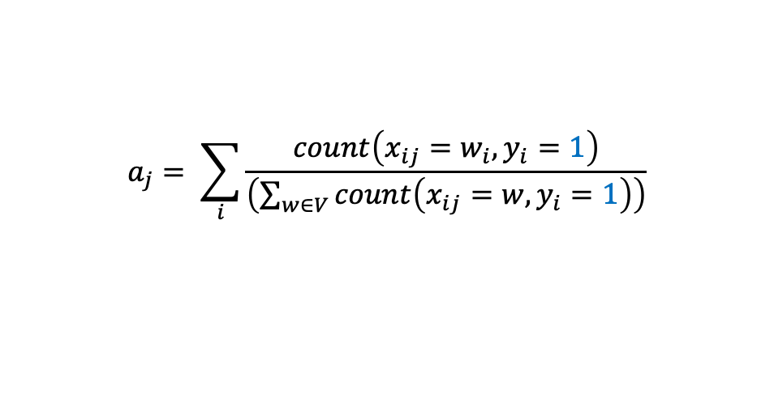
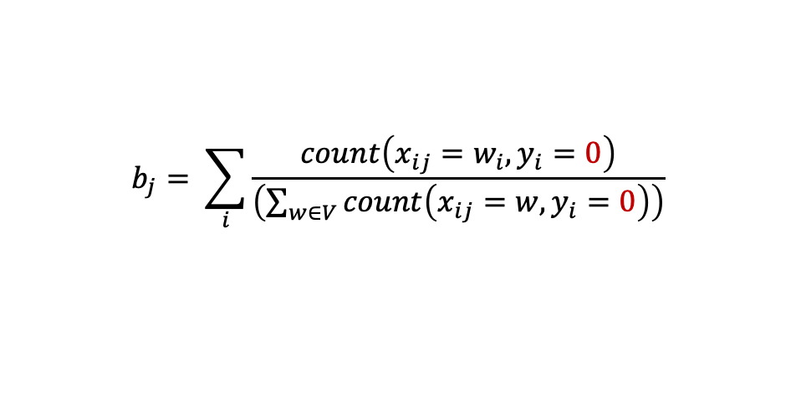
Learning the naïve Bayes Classifier
Maximum likelihood estimation (MLE)
Count and divide!
refer back to you ML class (e.g. CM146) about why, but for this class, you just need to remember this simple rule.
P(y = 1) = p
$$a_{j}= \sum_{i}{\frac{count\left(x_{ij}=w_{i}, y_{i}=1\right)}{\left(\sum_{w∈V}{count\left(x_{ij}=w,y_{i}=1\right)}\right)}}$$
P(x_{j} = 1 | y = 1) = a_{j}
$$b_{j}= \sum_{i}{\frac{count\left(x_{ij}=w_{i}, y_{i}=0\right)}{\left(\sum_{w∈V}{count\left(x_{ij}=w,y_{i}=0\right)}\right)}}$$
P(x_{j} = 1 | y = 0) = b_{j}
Since we’re using BoW features, we usually have x_{j} = “good”/“bad”/“movie”…
30

Slide 31
Naïve Bayes: Learning and Prediction
Learning
Count how often features occur with each label. Normalize to get likelihoods
Priors from fraction of examples with each label
Prediction
Use learned probabilities to find highest scoring label
How to do argmax?
31

Slide 32
Let's do a worked sentiment example!

Slide 33
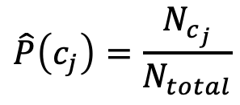
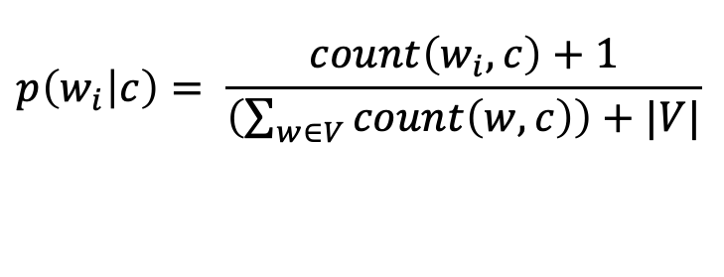
sentiment example
1. Prior from training:
$$\hat{P}\left(c_{j}\right)=\frac{N_{c_{j}}}{N_{total}}$$
P(-) = 3/5
P(+) = 2/5
2. Drop "with"
3. Likelihoods from training:
$$p\left(w_{i} | c\right)= \frac{count\left(w_{i},c\right)+1}{\left(\sum_{w∈V}{count\left(w,c\right)}\right)+|V|}$$
4. Scoring the test set:

Slide 34
Is this a good model?
”All models are wrong, but some are useful" – George Box, statistician
What's wrong with the BoW assumption?
What's wrong with the Naive Bayes assumption?
What if we don’t have enough data to estimate the probability from the counts?
Do we say p(x_{j}|y) = 0 if we don’t see x_{j} in the training data?
No. We’ll do smoothing (later topics)
But does it work?
Yes, for many tasks
And that's kind of all that matters
34
Notes:
Bow: Lisa bites a dog != a dog bites lisa

Slide 35
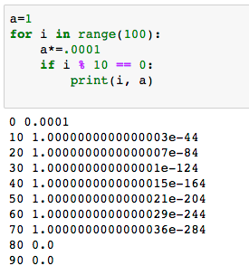
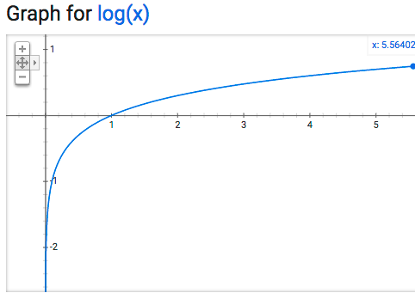
Practicalities: Underflow
Recall: for w in x: total *= wprobs[w][c]
x may be long! wprobs[w][c] may be small!
But remember log math!
exp(log(x)) = x
log(xy) = log(x)+log(y)
∀x, y > 0, x > y ⟺ log(x) > log(y)
35

Slide 36
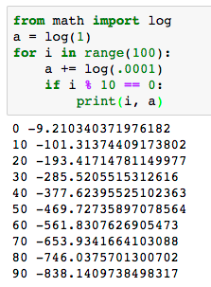
Avoiding Underflow with Logs
Now: for w in x: total += log(wprobs[w][c])
Note: exp(-838) ≈ 0
36

Slide 37
We learned/recapped: Naïve Bayes classifier
We will discuss/recap: Logistic Regression classifier
37

Slide 38
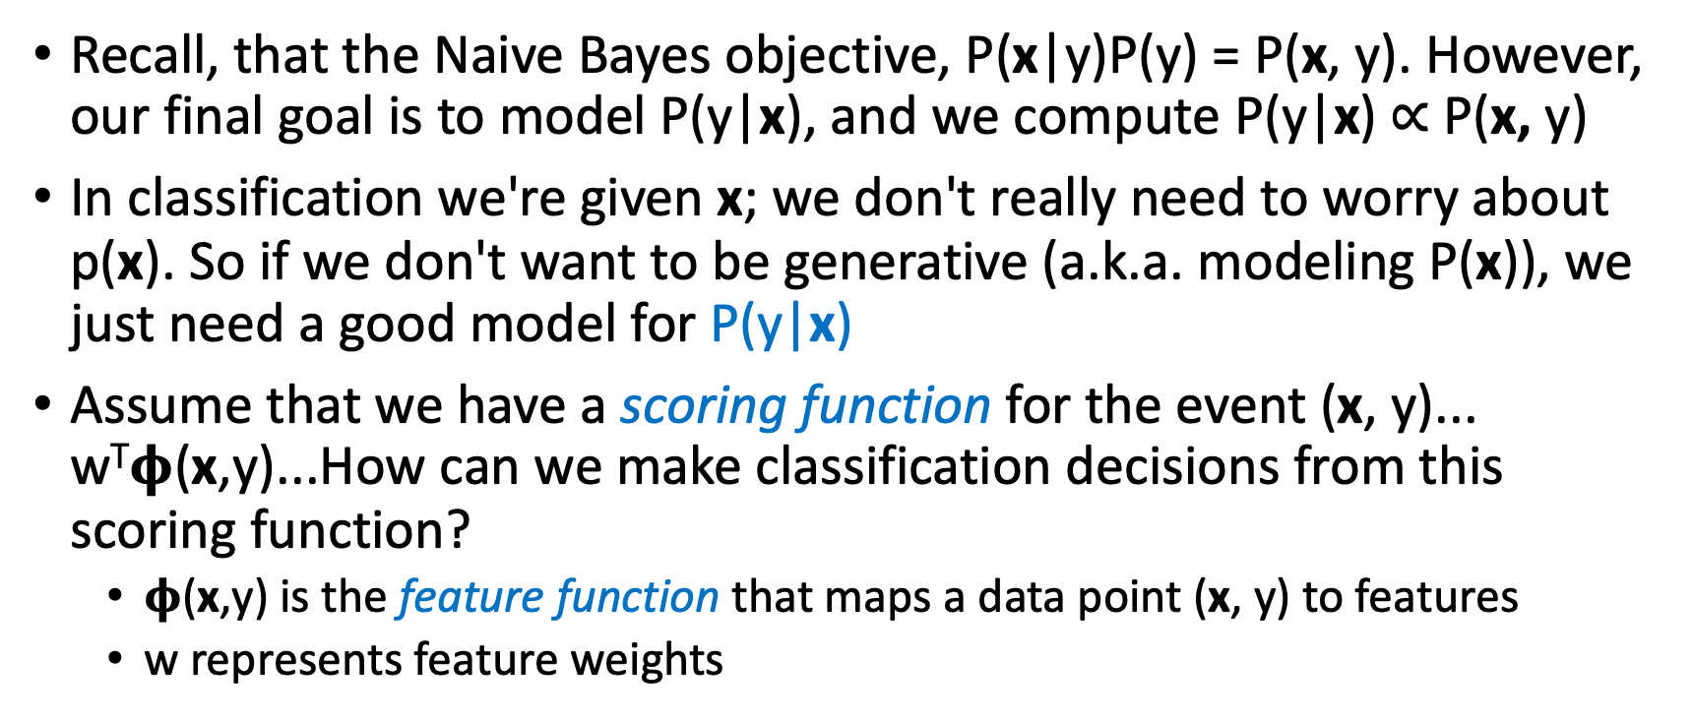
Generative vs. Discriminative Models
Recall, that the Naive Bayes objective, P(x|y)P(y) = P(x, y). However, our final goal is to model P(y|x), and we compute P(y|x) $∝$P(x, y)
In classification we're given x; we don't really need to worry about p(x). So if we don't want to be generative (a.k.a. modeling P(x)), we just need a good model for P(y|x)
Assume that we have a scoring function for the event (x, y)... w^{T}𝛟(x,y)...How can we make classification decisions from this scoring function?
𝛟(x,y) is the feature function that maps a data point (x, y) to features
w represents feature weights
38

Slide 39
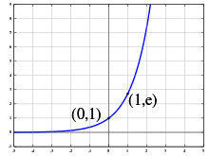
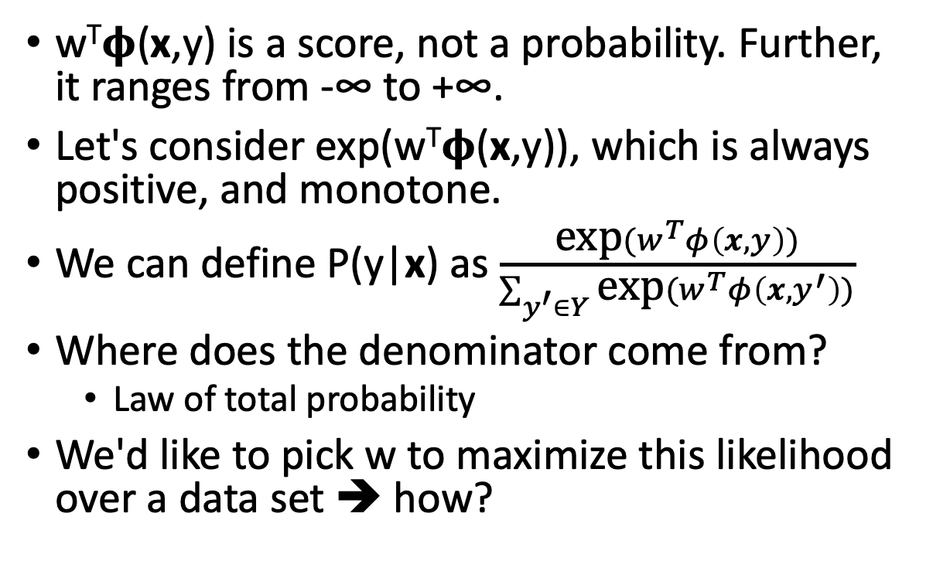
Making the score function probabilistic
w^{T}𝛟(x,y) is a score, not a probability. Further, it ranges from -∞ to +∞.
Let's consider exp(w^{T}𝛟(x,y)), which is always positive, and monotone.
We can define P(y|x) as $\frac{\text{exp}(w^{T}φ\left(x, y\right))}{\sum_{y^{′}∈Y}{\text{exp}(w^{T}φ\left(x, y^{′}\right))}}$
Where does the denominator come from?
Law of total probability
We'd like to pick w to maximize this likelihood over a data set ➔ how?
Graphics for exp(x)
Logistic Regression Classifier
The function is also called softmax function that is prevalently used in neural networks.
These slides based on notes of Jacob Eisenstein
39

Slide 40
Feature Engineering
𝛟(x,y) is feature function.
What can we use as features?
Recall Naïve Bayes Model
What else about a review might give us clues as to its sentiment? (discussion)
40

Slide 41
Other Features
Bigrams (“I love", ”love this”, “this movie”…)
Aside: NLPish for lengths of word sequence: unigram, bigram, trigram, 4-gram, ...
normalized unigrams
root form: "like" (instead of "liked", "liking", etc.) (cf. morphology lecture)
uncapitalized ("great!!!" instead of "Great!!!", "GREAT!!!")
punc-normalized ("Great !" instead of "Great!!!", "Great!!!!!")
spelling correction ("great" instead of "greate"...or "grate"??)
41

Slide 42
Other Features
length of the document (maybe positive reviews are shorter?)
average (max? min?) length of words
average (max? min?) length of sentences
other properties
contains sequence of all-caps words
author id
time of writing
Much of this is application-dependent; try it out and see what works!
Example:
This is the best movie I’ve watched in the past year! I love it!
42

Slide 43
How To Choose Features?
It's helpful to know something about your domain when designing features
is metadata important?
is there something very particular about the task at hand that should be checked (e.g. detecting the writings of a psychopath who only writes in sentences with a prime number of words)
Should I just use every possible feature I can think of?
More features => more flexibility
More features => more expensive to train
More features => more overfitting
43

Slide 44
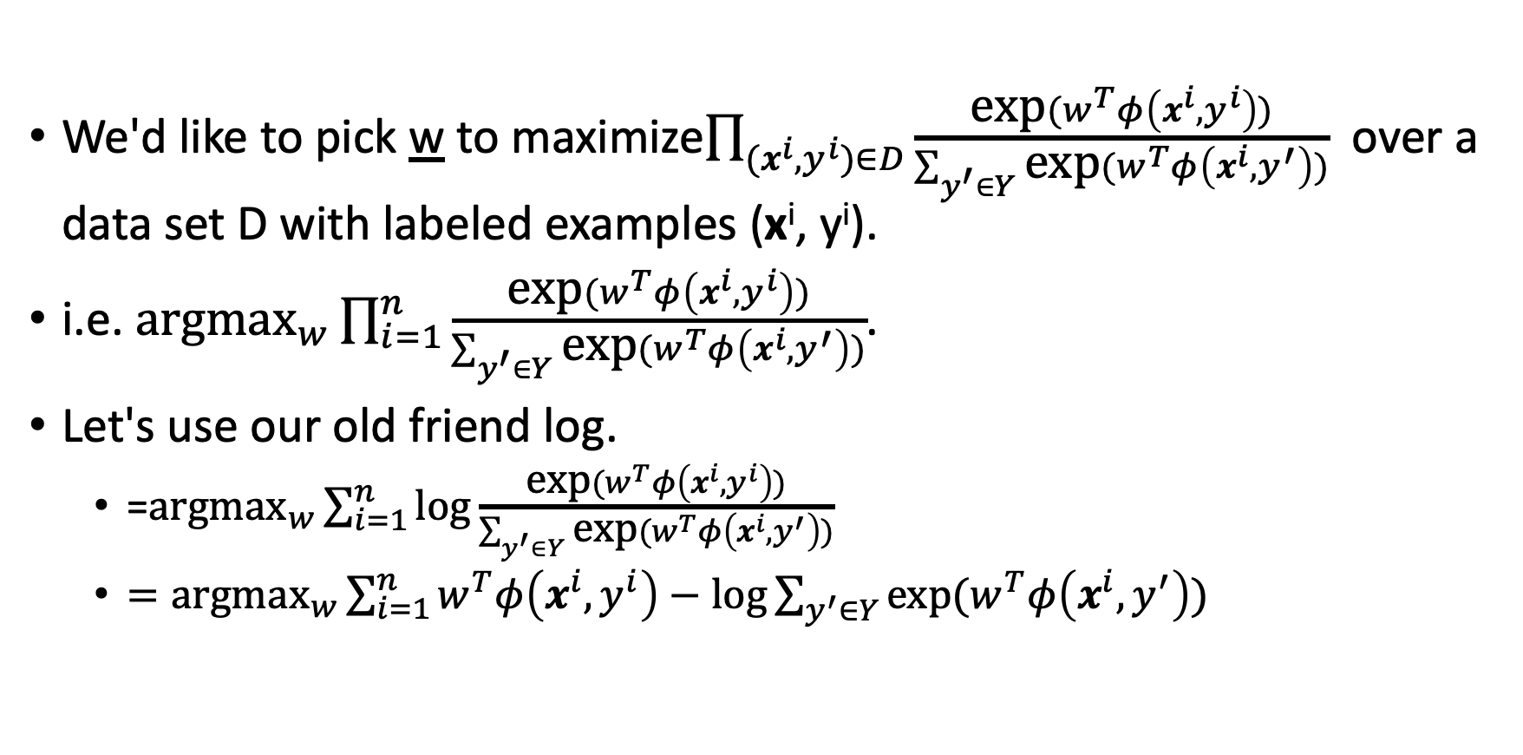
Maximizing Likelihood
We'd like to pick w to maximize$\prod_{(x^{i}, y^{i})∈D}{\frac{\text{exp}(w^{T}φ\left(x^{i}, y^{i}\right))}{\sum_{y^{′}∈Y}{\text{exp}(w^{T}φ\left(x^{i}, y^{′}\right))}}}$ over a data set D with labeled examples (x^{i}, y^{i}).
i.e. ${\text{argmax}}_{w}\prod_{i=1}^{n}{\frac{\text{exp}(w^{T}φ\left(x^{i}, y^{i}\right))}{\sum_{y^{′}∈Y}{\text{exp}(w^{T}φ\left(x^{i}, y^{′}\right))}}}$.
Let's use our old friend log.
=${\text{argmax}}_{w}\sum_{i=1}^{n}{\text{log}\frac{\text{exp}(w^{T}φ\left(x^{i}, y^{i}\right))}{\sum_{y^{′}∈Y}{\text{exp}(w^{T}φ\left(x^{i}, y^{′}\right))}}}$
$={\text{argmax}}_{w}\sum_{i=1}^{n}{w^{T}φ\left(x^{i}, y^{i}\right)−\text{log}\sum_{y^{′}∈Y}{\text{exp}(w^{T}φ\left(x^{i}, y^{′}\right))}}$
44

Slide 45
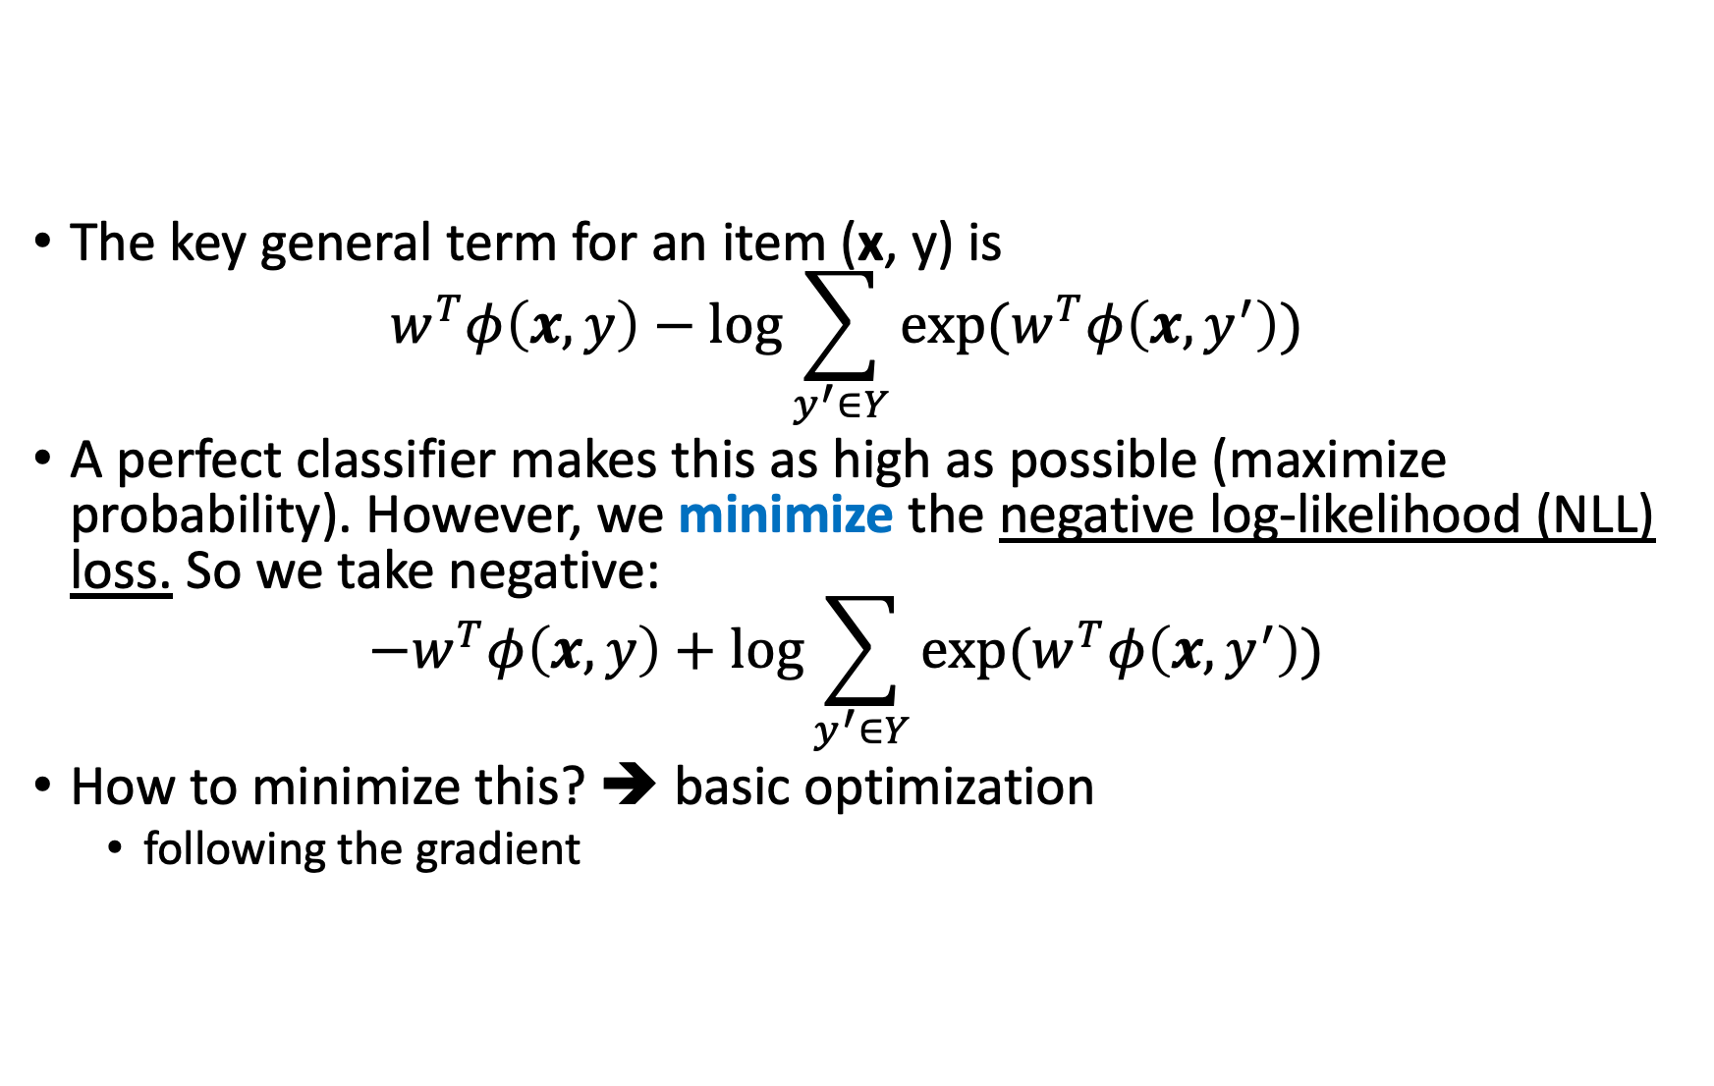
Maximizing Log Likelihood
The key general term for an item (x, y) is $w^{T}φ\left(x, y\right)−\text{log}\sum_{y^{′}∈Y}{\text{exp}(w^{T}φ\left(x, y^{′}\right))}$
A perfect classifier makes this as high as possible (maximize probability). However, we minimize the negative log-likelihood (NLL) loss. So we take negative: ${−w}^{T}φ\left(x, y\right)+\text{log}\sum_{y^{′}∈Y}{\text{exp}(w^{T}φ\left(x, y^{′}\right))}$
How to minimize this? ➔ basic optimization
following the gradient
45

Slide 46
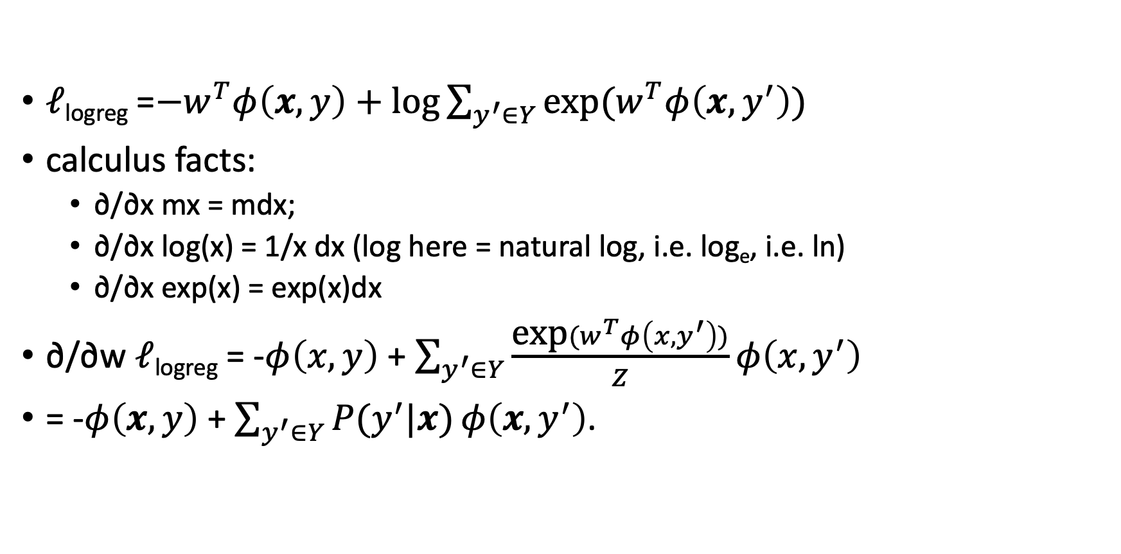
Gradient for Logistic Regression
𝓁_{logreg} =${−w}^{T}φ\left(x, y\right)+\text{log}\sum_{y^{′}∈Y}{\text{exp}(w^{T}φ\left(x, y^{′}\right))}$
calculus facts:
∂/∂x mx = mdx;
∂/∂x log(x) = 1/x dx (log here = natural log, i.e. log_{e}, i.e. ln)
∂/∂x exp(x) = exp(x)dx
∂/∂w 𝓁_{logreg} = -$φ\left(x, y\right)$ + $\sum_{y^{′}∈Y}{\frac{\text{exp}(w^{T}φ\left(x, y^{′}\right))}{Z}}φ\left(x, y^{′}\right)$
= -$φ\left(x, y\right)$ + $\sum_{y^{′}∈Y}{P(y^{′}|x)}φ\left(x, y^{′}\right)$.
Actual feature count in the training instance
Expected feature count under the current model

Slide 47
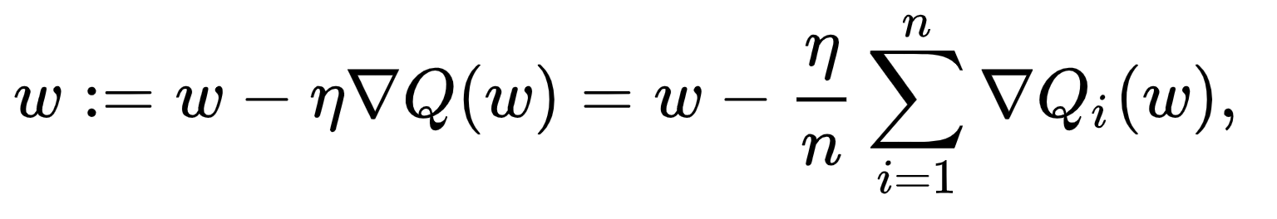
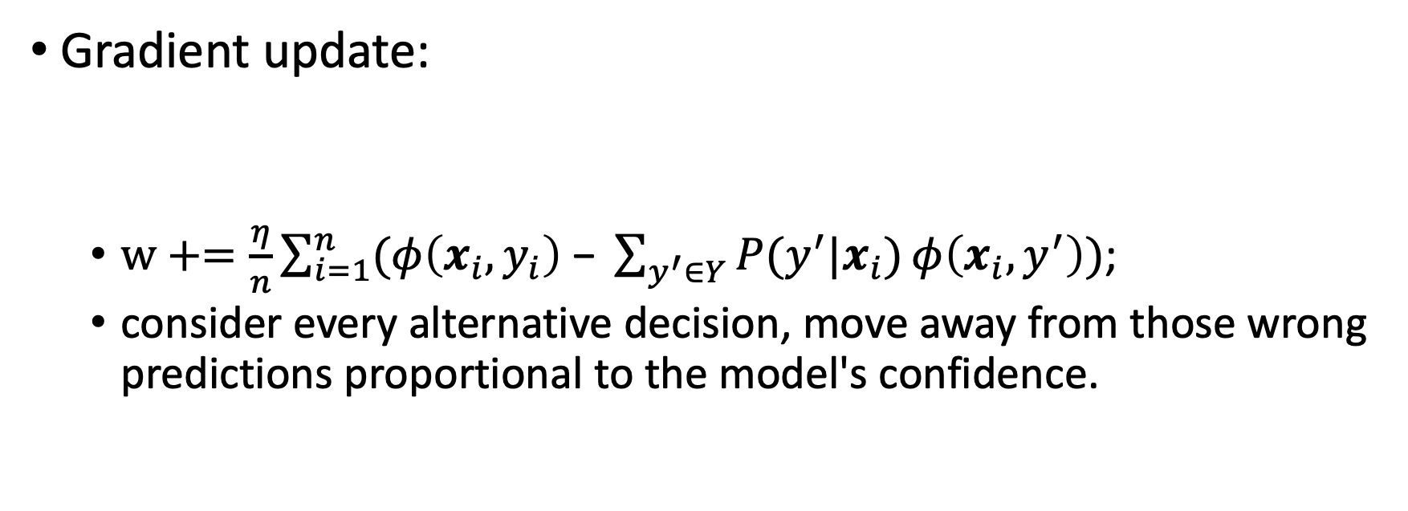
Gradient Update of Logistic Regression
Gradient update:
$w+=\frac{η}{n}\sum_{i=1}^{n}{(φ\left(x_{i}, y_{i}\right)\text{ − }\sum_{y^{′}∈Y}{P(y^{′}|x_{i})}φ\left(x_{i}, y^{′}\right))}$;
consider every alternative decision, move away from those wrong predictions proportional to the model's confidence.

Slide 48
Naïve Bayes Vs. Logistic Regression
Naïve Bayes
Logistic Regression
Generative model
Probabilistic
Close form solution
Independence assumption
Easy to write
Fast to learn
Can overfit
Discriminative model
Probabilistic
Iterative solution
No independence assumption
Slow to write
Slow to learn
Can overfit
Foundation of deep learning optimization

Slide 49
Conclusions
We discussed supervised learning for text classification
Classifier takes an input (such as a text document) and predicts an output (such as a class label)
Learner takes training data and produces (statistics necessary for) the classifier
The Naive Bayes model and Bag of Words assumption are a simple, fast probabilistic approach to text classification
Logistic Regression allows more arbitrary feature at the cost of slower learning and a requirement of more data
Spoiler: LLMs classifiers are essentially logistic regression.

Slide 50
Next...
Introduction to semantics
Lexical semantics
Semantic phenomena and representations

